Slide 1
US Education Sector Analysis (Pre-K to 12, 2006 to 2015) Team ETA qIQIONG yU pATRICK SIEWE niDHI TRIVEDI
Notes:
The U.S. Department of Education is working with states, systems, and leaders to raise standards across the Pre-K–12 spectrum; increase access to high-quality preschool; improve teaching; establish strong systems for technology and data; turn around persistently underachieving K-12 schools; and increase college access, affordability, quality, and completion.

Slide 2
How does the student enrollment vary over time in us?
INTRODUCTION
Objective:
Analyze U.S Education Data for Pre-k to 12th Grade Students to identify trends, co-relations, patterns
Choice of Topic :
Relatable
Dataset size, constituents (multiple dimensions), recency of update
Questions we had in mind 11. Slide 11
About the Dataset:
Link : U.S Dataset from Kaggle
Source : Data is sourced from the U.S. Census Bureau and the National Center for Education Statistics (NCES).
Data Analysis Consists of
United States Overall
Top States
Race & Gender
Revenue and Expenditure
Enrollment Count
Student Performance (Grade 4 and Grade 8, Math and Reading)
4/2/19
US Education Data Analysis, 2006 - 2015
3
Notes:
The U.S. Department of Education is working with states, systems, and leaders to raise standards across the Pre-K–12 spectrum; increase access to high-quality preschool; improve teaching; establish strong systems for technology and data; turn around persistently underachieving K-12 schools; and increase college access, affordability, quality, and completion.

Slide 3
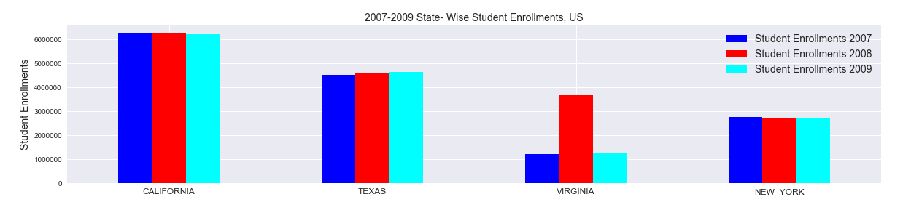
How does the student enrollment vary over time in us?
Student enrollment count over the years, us 2006 - 2016
The enrollments over the years are at an Average of 48 Mn
Number of Student enrollments showed a 5% increase (5%) in 2008
TOP STATES WITH THE HIGHest STUDENT ENROLLMENTs, us 2008 & 2009
Year
On further deep-dive, VIRGINIA state was seen contributing maximum to this rise in student enrollments in 2008 (200%)
4/2/19
US Education Data Analysis ,2006 - 2015
State
4
Notes:
The U.S. Department of Education is working with states, systems, and leaders to raise standards across the Pre-K–12 spectrum; increase access to high-quality preschool; improve teaching; establish strong systems for technology and data; turn around persistently underachieving K-12 schools; and increase college access, affordability, quality, and completion.

Slide 4
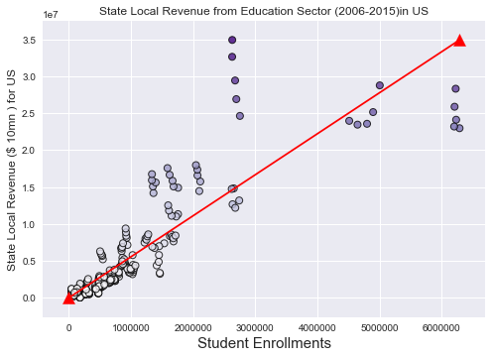
Revenue Vs expenditure
of states in education sector, us
2006 TO 2015
DOES THE LOCAL REVENUE COLLECTED BY STATES VARY WITH THE STUDENT ENROLLMENT COUNT?
Year
Student Enrollments
State Government has increased its expenditure towards education sector over the years
This has led to more students getting enrolled in schools
Government Expenditure always exceeds the total Revenue (Local and from State, Federal) in education
P-value < 0.05 and hence there is a strong relationship between the count of students enrolled schools and the local revenue collected by the state government
4/2/19
US Education Data Analysis, 2006 - 2015
5
Notes:
The U.S. Department of Education is working with states, systems, and leaders to raise standards across the Pre-K–12 spectrum; increase access to high-quality preschool; improve teaching; establish strong systems for technology and data; turn around persistently underachieving K-12 schools; and increase college access, affordability, quality, and completion.

Slide 5
STUDENTS’ PERFORMANCE OVER THE YEARS IN GRADE 4 AND GRADE 8, US 2006-2019
Students’ Performance
Students in US are better at Math than Reading in Grade 4 and Grade 8
Students’ performance has improved over the years for both the grades
4/2/19
US Education Data Analysis, 2006 - 2015
6
4/2/19
6

Slide 6
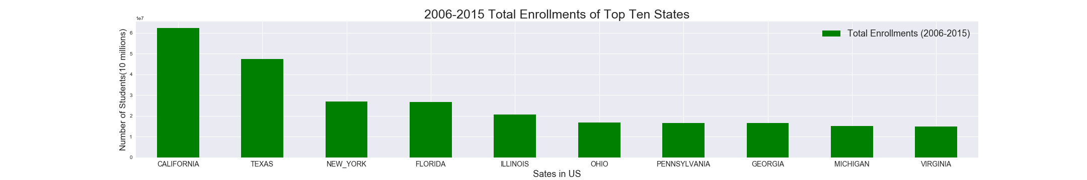
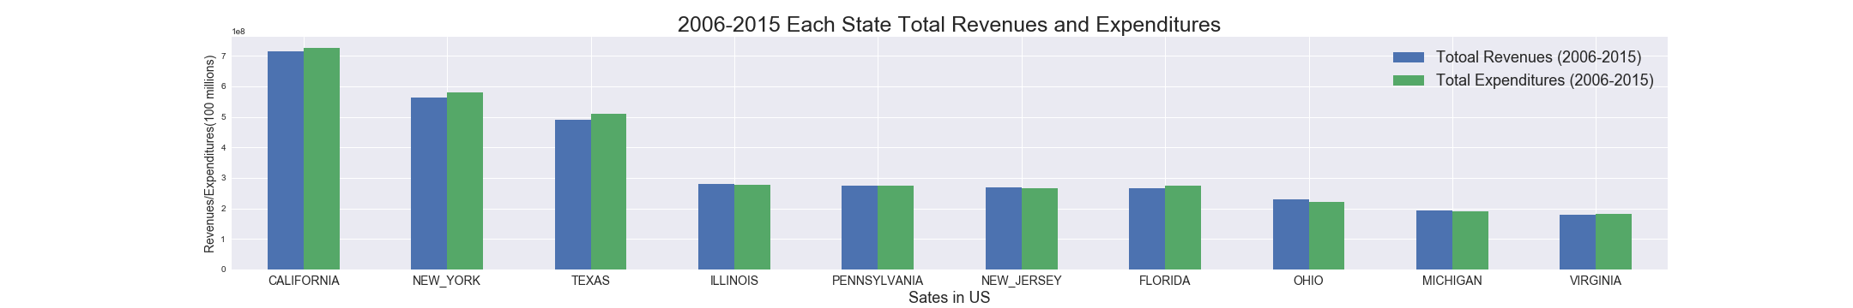
TOP US State STUDENT ENROLLMENTS, REVENUE AND EXPENDITURE, 2006-2015
62,356,793
Higher population leads to higher enrollment
$714,237,746 (Revenue)
$725,199,385 (Expenditure)
School districts receive money per student based on attendance, not enrollment.
Expenditures > Revenues
But in the current data Revenues don’t include incomes from afternoon school programs or donations.
US Education Data Analysis, 2006 - 2015

Slide 7
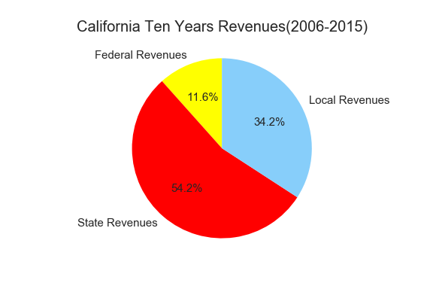
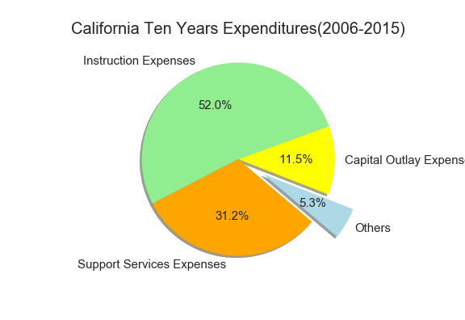
CALIFORNIA STATE REVENUE (2006-2015)
CALIFORNIA STATE EXPENDITURE
(2006-2015)
Instruction and support service expenditures are major expenses for public schools
Instruction: Teachers’ salaries, benefits(insurances)
Support Service: Other staff salaries, transportation
Others: Books , instructional supplies
Capital Outlay: Acquire, maintain, repair, or upgrade assets (new classrooms, specialized equipment - science labels or computer rooms )
State Revenue (state sales and income taxes, lotteries, and property taxes ) constitutes the maximum towards Education Revenues.
Local Revenue comes from local taxation system (property taxes – buildings or lands)as well.
California Federal Revenue is higher than the average federal revenue contribution for US States -9%
US Education Data Analysis, 2006 - 2015

Slide 8
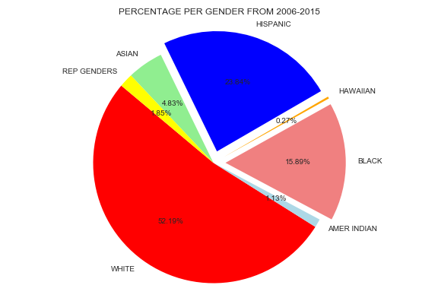
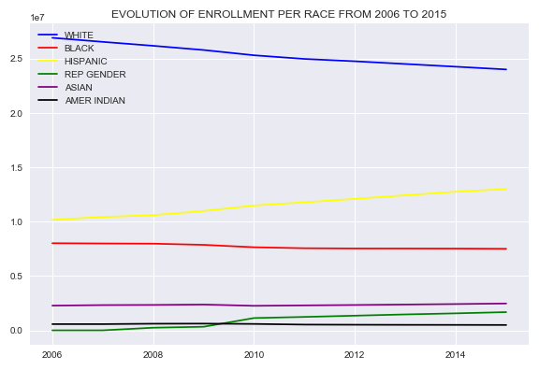
Student enrollments by RACE, US 2006-2015
Student enrollments by RACE OVER THE YEARS, us 2006-2015
Race
Race
Whites are the highest number of students enrolled in US followed
by Hispanics
Although the Whites are higher in population, the student enrollment count for Whites is reducing year on year, while the more Hispanics are getting enrolled in schools
4/2/19
US Education Data Analysis, 2006 - 2015
9

Slide 9
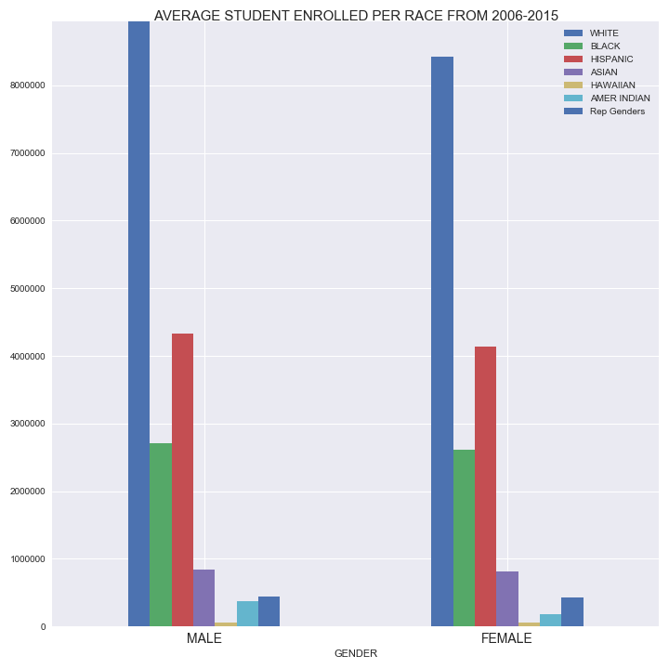
Student enrollments by Gender, us 2006-2015
Male percentage in US Students : 51.36%
Female percentage in US Students : 48.34%
Race wise distribution in both the genders is similar
Gender
US Education Data Analysis, 2006 - 2015

Slide 10
Conclusion
Student Enrollments in US over the years (2006 – 2015) have remained at an average of 48 Mn
States with a higher population have higher number of students enrolled
2008 showed a spurt in student enrollments due to 203% increase in students enrollments in Virginia State
Instruction and support service expenditures are major expenses for public schools
States spend higher on education facilities, infra and instructional support than the revenue from state, federal and local revenues during majority of the years
Enrollments
Expenditure
US Students are better at Math than Reading
Students’ performance has improved over the years for both the grades
Performance of Hispanics has improved for Grades 4 and 8 over the years
Public school funding comes from federal, state and local sources
State Revenue for education and the State Expenditure for educational infra, instructional facilities and support increased over the years.
State Local Revenues collected increase with the increase in the number of student enrollments
State funding accounts for more than a half of education revenues for each state
Performance
Revenue
Male percentage in US Students : 51.36%
Female percentage in US Students : 48.34%
Whites are the highest students enrolled in US followed by Hispanics
Gender and Race
US Education Data Analysis, 2006 - 2015

Slide 11
Future Research
Include College Data for analysis
Include District Level Analysis
Student Performance relation with Affluent and Low Income Area Schools
Include Funding analysis basis the school location (Rich areas Vs Poor)
Include Grade wise enrollment study
Performance by Gender
US Education Data Analysis, 2006 - 2015

Slide 12
Thank You!
Any Questions?

Slide 13
Questions
How does the Student Enrollment count change over time in US?
What is the gender and Race disparity look like?
What is the year on year trend in Total Revenue and Expenditure across US States?
Does the State local revenues vary with the student enrollment?
What are the top states contributing to the US Revenue, Expenditure and Student Enrollment count?
What is the Student performance in US year on year?
How do the Gender and Race split look like in Students and their performance?

Slide 14
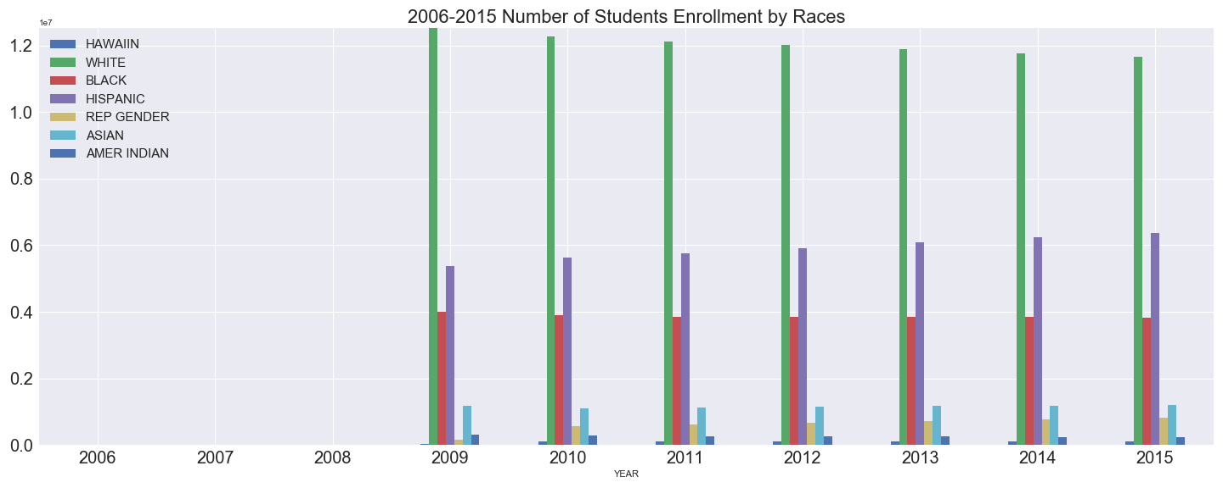
Students’ Performance – Best state performer

Slide 15
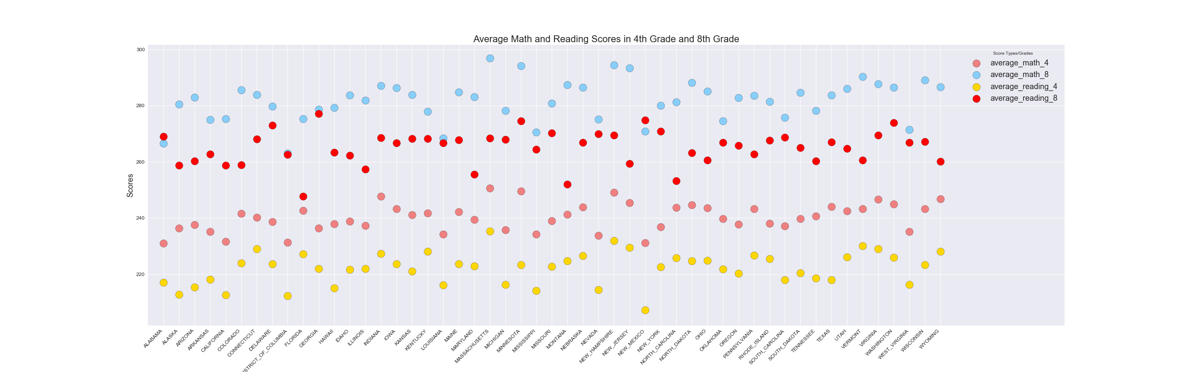
Each State Students Average Math and Reading Scores in 4th Grade and 8th Grade

